Slide 1
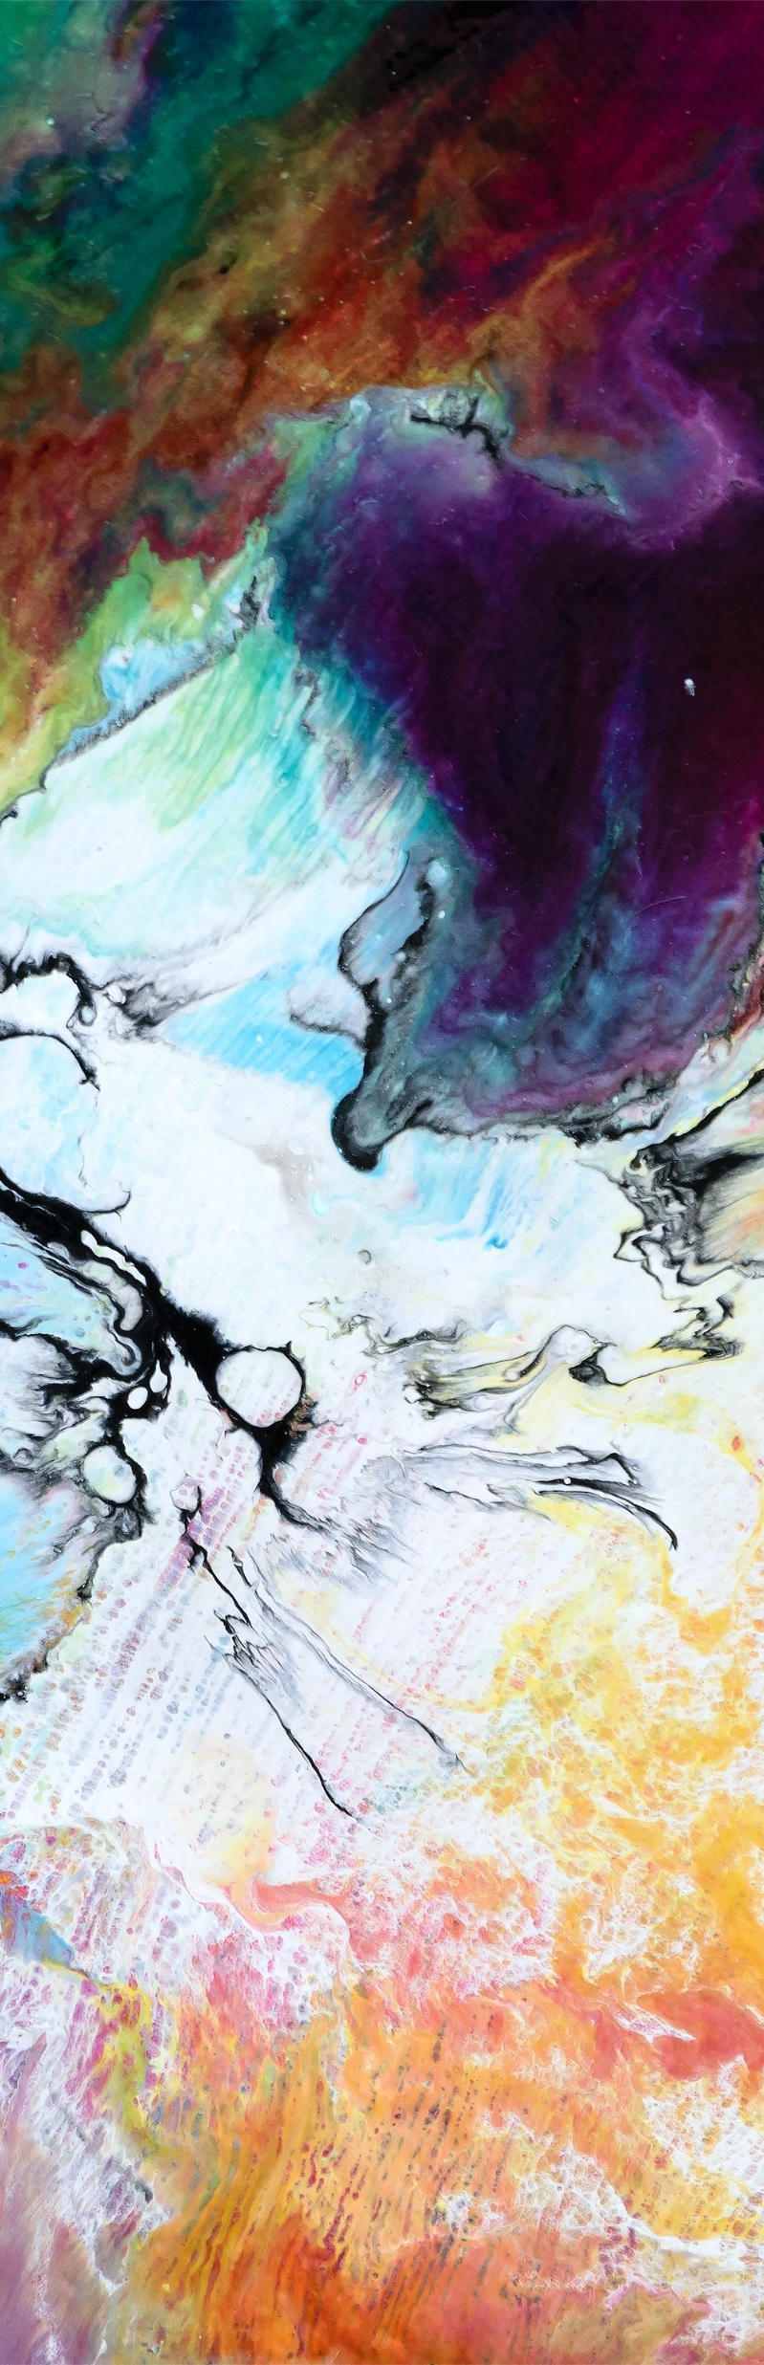
raspedal
The free DSP platform

Slide 2
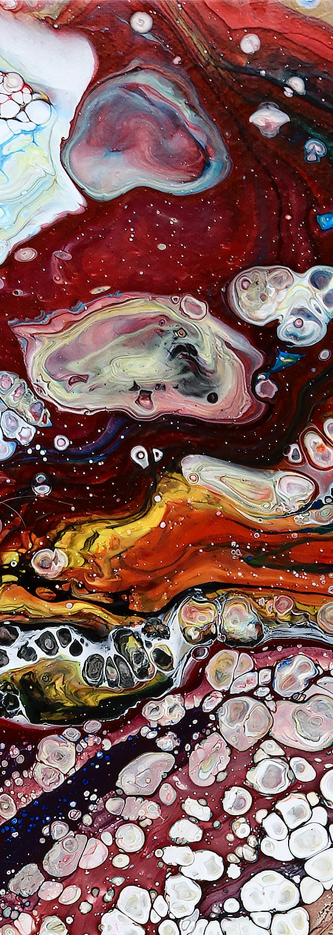
raspedal
The free DSP Platform
High-end audio quality
Low production cost
Open-source
Easy replication

Slide 3
Main components
Raspberry Pi 3
Audio Injector
gtkIOStream

Slide 4
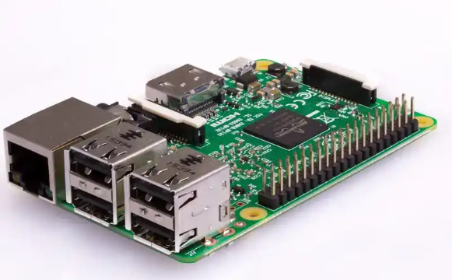
Raspberry pi 3
Quad-Core 1.2GHz CPU
Ready-to-use HDMI and USB ports
Raspberry, a Debian-based OS
Production and support assured until 2022

Slide 5
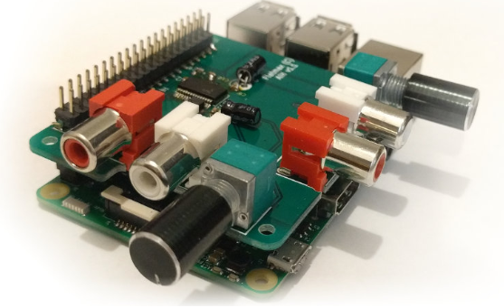
Audio Injector Sound CArd
Up to 96kHz
32-bit resolution
Input and output gain control
Production and support assured until 2022

Slide 6

Gtk iostream
C++ implemented library
ALSA interface
DSP and machine learning libraries integration

Slide 7
Effects
Fuzz
Delay
Tremolo
Filter

Slide 8
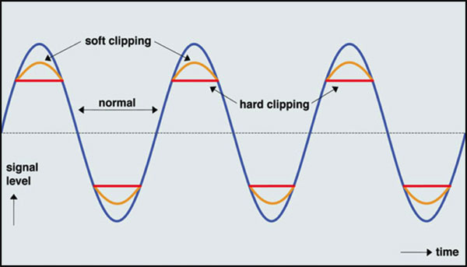
fuzz

Slide 9
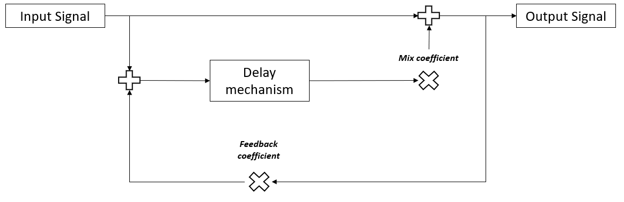
Delay

Slide 10
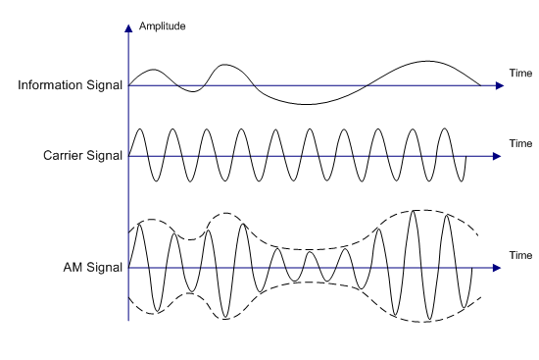
tremolo

Slide 11
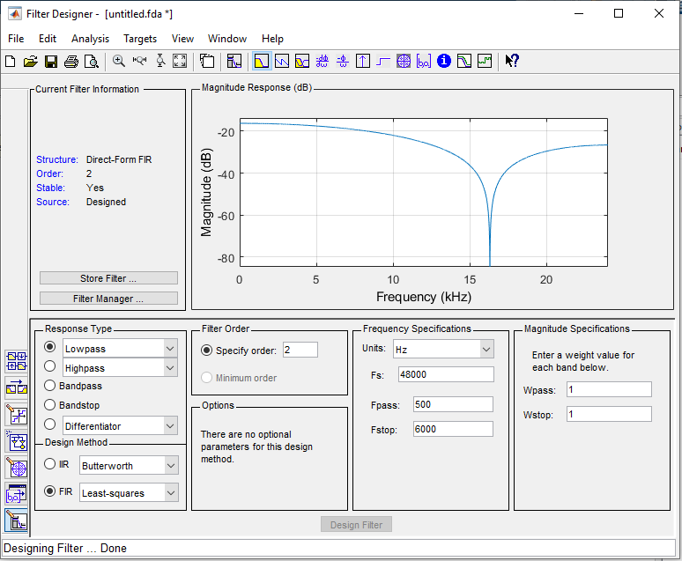
filter

Slide 12
demonstration

Slide 13



THANK YOU
RASPEDAL THE FREE DSP PLATFORM
Eduardo H. F. Silva
+55 12 99620 5701
eduardo.hferreiras@gmail.com
https://github.com/eduardohferreiras/RasPedal

